Slide 1
Sen-220 software engineering
SCRUM

Slide 2
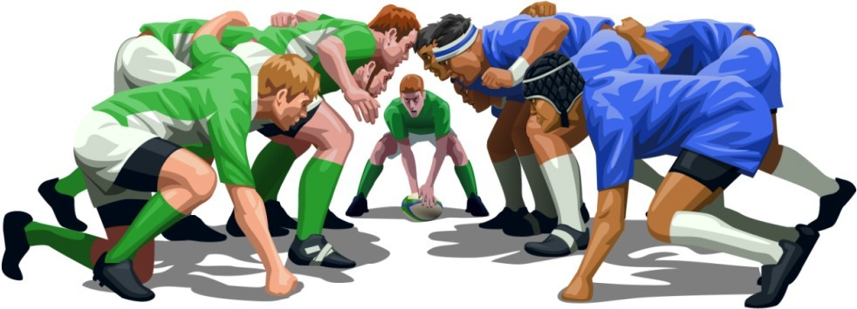
What is SCRUM?
A scrum (short for scrummage) is a method of restarting play in rugby that involves players packing closely together with their heads down and attempting to gain possession of the ball.

Slide 3
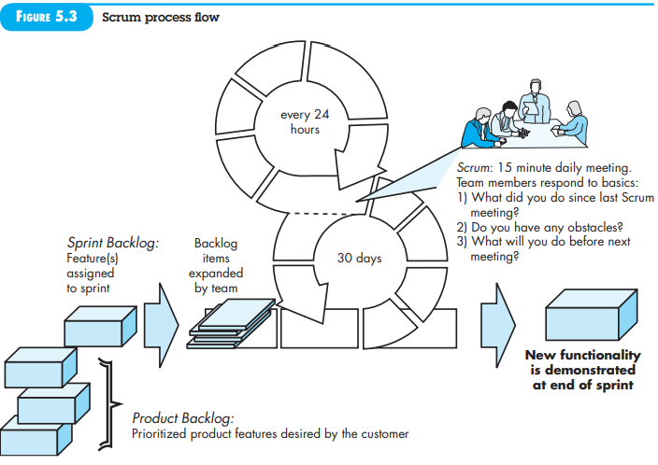

Slide 4
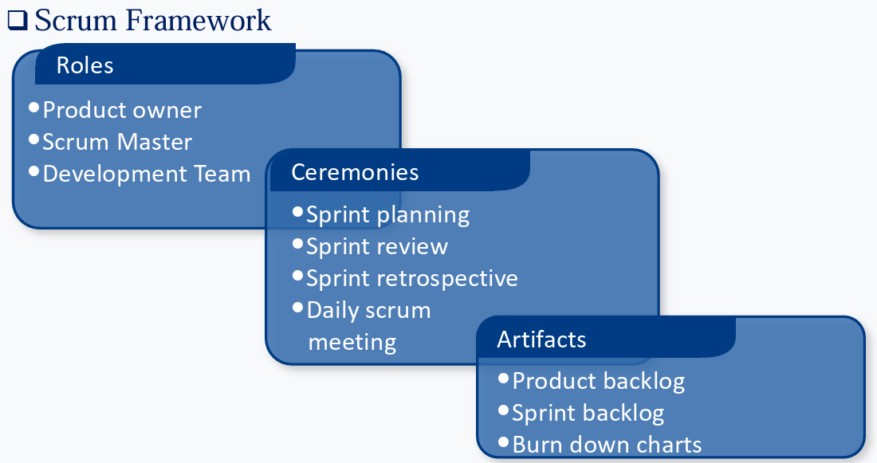
SCRUM FRAMEWORK

Slide 5
User story
User Story
A user story is a simple, concise description of a feature told from the perspective of the end user. It typically follows the format: "As a [type of user], I want [some goal] so that [some reason]." User stories help teams understand what users need and why, guiding the development process.
○ For Example: As a registered user I want to log in so I can access subscriber-access content.
Story points are a way for teams to measure how hard or complex tasks are, helping them plan their work better without worrying about exact time estimates.

Slide 6
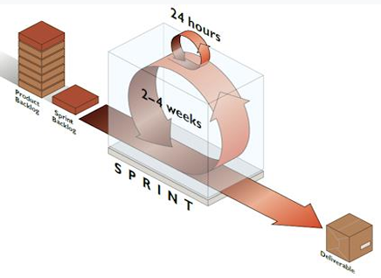
Sprint
A sprint is a short period of time, usually 2-4 weeks, during which a team works on a specific set of tasks for a goal.
It's like a mini-project with a clear objective to achieve by the end of the sprint.
Sprint is time boxed and can not be extended under any circumstances, irrespective of whether all the user stories committed are delivered or not.
If any user story or part of a user story is pending after the sprint completion time, that particular user story will be moved back to the product backlog for reprioritization.

Slide 7
Scrum Roles and responsibilities
Product Owner
○ Responsible person for release burn-down chart
○ Responsible for the product vision
○ Person who maintains the product backlog and the responsible person for the same
○ Only person who can make a decision whether the product is ready to ship
○ Only authoritative person to take a decision about abruptly discontinuing/stopping the sprint
○ Person responsible to provide the clarification on the user story to the development team whenever needed
○ Only authoritative person to take the decision of including any further functionality to the product backlog
○ Person to constantly reprioritize the product backlog

Slide 8
Scrum Roles and responsibilities
Scrum Master
○ Facilitator of the Scrum process
○ Helps resolving any issues/impediments faced by the Scrum team
○ Shields the team from external interferences and distractions
○ Creates a positive environment for the team to be self-organizing
○ Enforces time boxes
○ Person who maintains sprint burn-down charts
○ Person who facilitates the required meetings
○ Has no management authority for the team (for example, he or she can not command the team to do a specific task)
○ Promotes improved practices of engineering
○ Only person who can take the escalations or request to the top management

Slide 9
Scrum Roles and responsibilities
Development Team
○ Should be a self-organizing and cross-functional team (consists of the members with testing, development, business analyst, domain expertise, etc., skills)
○ Should self-manage the tasks among the team
○ Should resolve people management issues if any among the team and should only take it to Scrum Master if it has gone out of the team’s control
○ Works with product owner in reprioritizing the product backlog items
○ Consists of 7 + /-2 members
○ Responsible to complete the committed task for the sprint

Slide 10
Sprint planning
Imagine you're a team of developers building a new mobile app. Sprint planning is like a quick team meeting before you start working on a specific set of features.
The meeting's purpose:
Decide what features to tackle first (like the most important app functionalities for this sprint) [SPRINT GOAL]{User Story}.
Figure out how to build them (how the development team will approach each feature) [SPRINT BACKLOG]{Tasks}.
Set a common goal for the sprint (what the team wants to achieve by the end of this work period).
Who attends: The entire development team (programmers, designers, testers).
The outcome: A clear plan for the next few weeks (sprint) with a specific goal (what features to deliver) and a list of tasks to complete each feature (how you'll build them).

Slide 11
Sprint Goal and sprint backlog
Sprint Goal: Short-term objective for the sprint, what the team aims to achieve.
Sprint Backlog: Plan for how to achieve the sprint goal, what tasks the team will do.

Slide 12
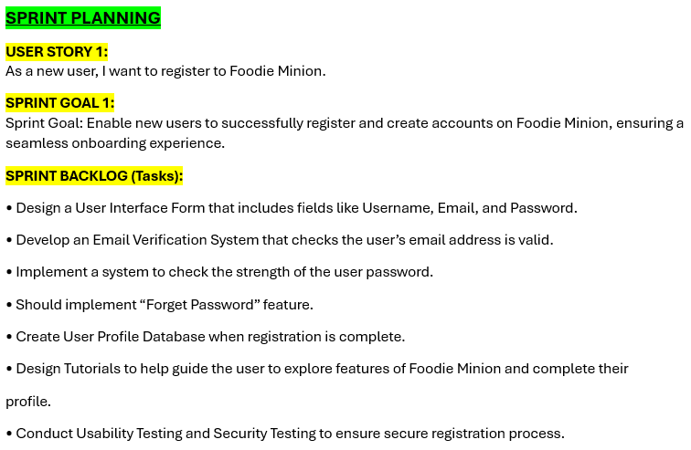

Slide 13
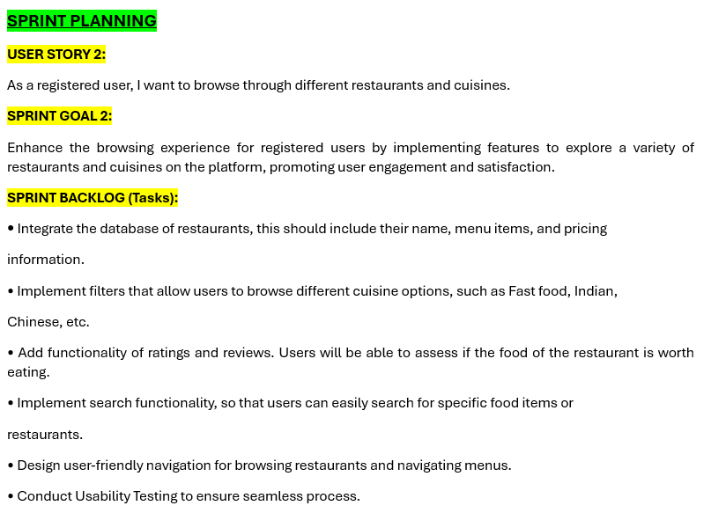

Slide 14
Sprint Review and Sprint Retrospective
Sprint Review
○ After the completion of every sprint, the Scrum team holds a sprint review meeting to demonstrate the working product that was developed and tested as part of the sprint
○ Attendees: Scrum Master, Product Owner , Development team, and all the stakeholders/sponsors, Customers
Sprint Retrospective
○ No matter how good a Scrum team is, there is always room for improvement
○ After every sprint, the Scrum team schedules an internal meeting that is the last meeting in the sprint, to assess what went wrong and what went well
○ The Scrum Master facilitates this meeting by asking everyone to explain their ideas
○ Attendees: Scrum Master, Product Owner, Development Team

Slide 15
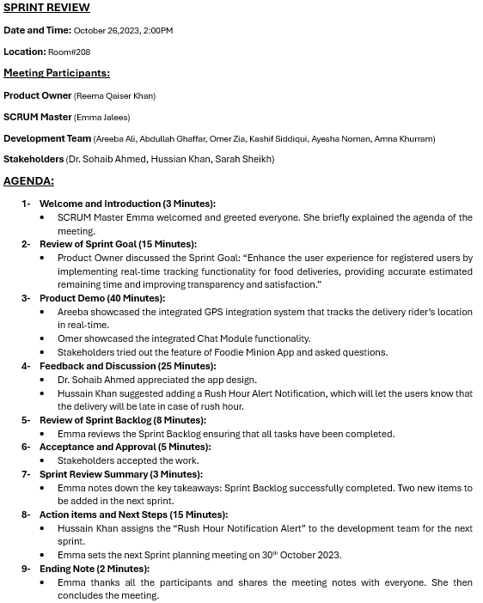
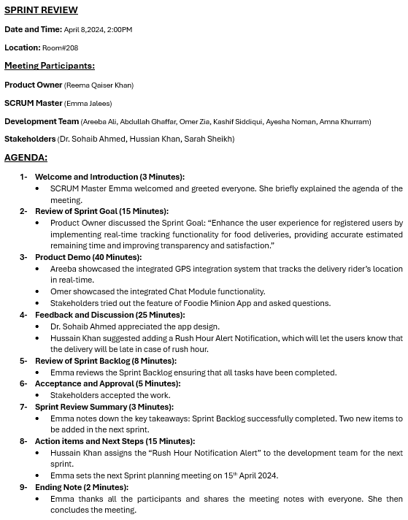
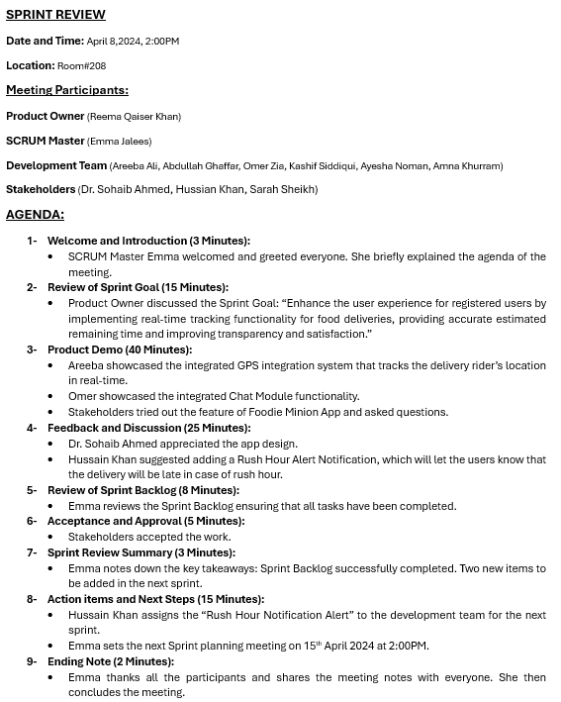

Slide 16
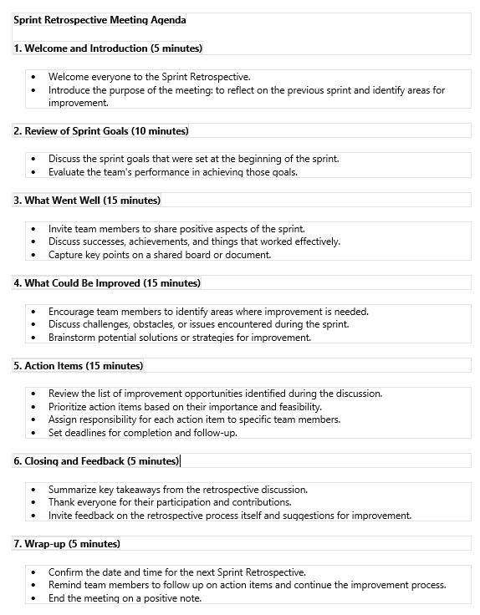

Slide 17
Daily scrum meeting
Daily Scrum Meeting
○ Daily, ~15 minutes, Stand-up
○ Anyone late pays a few amount (say Rs 100)
○ In a daily scrum meeting, the Scrum Master doesn't ask the specific questions about individual progress. While they facilitate the meeting and ensure it stays on track, they don't participate in status updates.
○The development team and product owner participate along with the Scrum master
○ Helps avoid other unnecessary meetings
❑ Three questions answered by each team member:
What did you do yesterday? What will you do today? What obstacles are in your way?

Slide 18
Product backlog
The product backlog is the list of functionalities with the short descriptions derived from the requirements and the roadmap of the project; and they are displayed in terms of user stories.
User stories are prioritized by the product owner.
Responsibility of managing the product backlog lies with the product owner.

Slide 19
Product backlog
Backlog Items | Estimate (Story Points)
As a new user, I want to register to Foodie Minion. | 3
As a registered user, I want to browse through different restaurants and cuisines. | 5
As a registered user, I want to browse menu items with clear descriptions, images, and prices. | 5
As a registered user, I want to save my favorite restaurants and orders for reordering. | 8
As a registered user, I want to rate and review restaurants and delivery riders. | 5
As a registered user, I want to filter restaurants based on estimated delivery time. | 8
As a registered user, I want to cancel my order and lodge a complaint. | 8
As a registered user, I want to have multiple payment options i.e., cash on delivery and online bank payment. | 13
As a registered user, I want to track my food delivery in real-time, giving me estimated remaining time as well. | 13
As a registered user, I want to use Foodie Minion on multiple devices and platforms. | 5
Total | 73

Slide 20
Sprint backlog
The sprint backlog is a subset of the product backlog that contains the specific set of tasks that the development team commits to completing during a sprint.
It's essentially a list of work items selected from the product backlog for implementation during the sprint.
The sprint backlog guides the team's work for the duration of the sprint and helps ensure that they focus on delivering the sprint goal.

Slide 21
Sprint backlog 1 [User story 1]
TASKS | MON | TUES | WED | THURS | FRI | MON | TUES | WED | THURS | FRI
Design a User Interface Form that includes fields like Username, Email, and Password. | 1 |  |  |  |  | 1
Develop an Email Verification System that checks the user’s email address is valid. | 1 | 1 |  |  |  | 1 | 1
Implement a system to check the strength of the user password. |  | 1 |  |  |  |  | 1
Should implement “Forget Password” feature. | 2 | 1 |  |  |  | 2 | 1
Create User Profile Database when registration is complete. |  |  | 3 | 2 |  |  |  | 3 | 2
Design Tutorials to help guide the user to explore features of Foodie Minion and complete their profile. | 2 |  |  |  |  | 2
Conduct Usability Testing and Security Testing to ensure secure registration process. |  |  |  |  | 2 |  |  |  |  | 2

Slide 22
Burn down chart
A burn down chart is typically created at the beginning of a sprint or project and updated throughout its duration.
It helps the team track their progress over time, showing how much work remains to be done and whether they are on track to meet their goals.

Slide 23
Burn down chart
This is a Burn Down Chart for Sprint Backlog 1.

Slide 24
Sprint backlog 2 [user story 2]
Show a sprint backlog for USER STORY 2 (SLIDE 12).
Create a burn down chart.

